Slide 1
Predicting Dispute Status using Machine Learning Approach
REVA Academy for Corporate Excellence (RACE)
March 6, 2021
Presenter : Madhukeshwar R K
Mentor : Mr. Dipajan Deb
www.reva.edu.in

Slide 2
AGENDA
01
Introduction
07
Data Preparation
02
08
Problem Statement
Data Modeling
03
Objectives of the Study
09
Deployment
04
10
Project Methodology
Analysis and Results
05
Business Understanding
11
Conclusions and Recommendations for future work
06
12
Data Understanding
GitHub Link

Slide 3
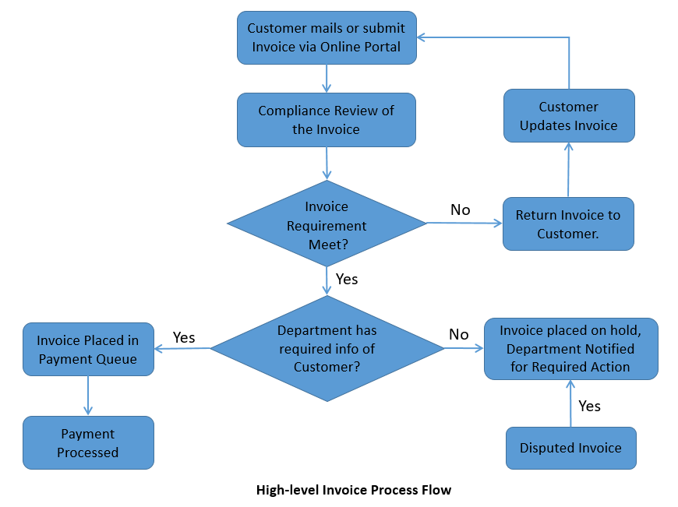
Introduction
Order to Cash business process involves account receivable collections after an invoice is issued to the customer.
Invoices are used where services and product are provided and they usually contain the rendered charges.
Typical payment terms provided would be of 30, 45 and 60 days to customer to make full payment of the invoiced amount.
In business certain customers do not make invoiced amount on time and an intervention actions are required for payment collection.
During the invoice process a dispute can be raised by the customer for the invoice which could be due to product mismatch or the exceptions of the delivery of the product is not meet.

Slide 4
Problem Statement
Customers raise disputes on invoices which eventually delay the invoice payment cycle based on either the disputed invoices get rejected or approved.
A typical dispute takes around 6 working days, thus giving the customer an additional 7 days for payment. This is over and above the usual payment term of 30 days.
Some disputes are genuine in the sense that invoices might not have met customer requirements as per contractual agreement while booking the orders.
Some customers may take this route to raise false disputes which gave them extra time to pay.
Dispute Raised
Payment Date | Internal Verification | Extended Days | Total Days
30 Days | 7 Days | 7 Days | 45 Days
Predicting the disputed status of invoices - will get approved or rejected using appropriate Machine Learning Algorithms and to explore the key drivers leading to disputes. The purpose is to help the business stakeholders to reduce such disputes in future leading to financial stress. Better management of disputes also will lead to better customer satisfaction.

Slide 5
Objectives of the Study
Two major objectives of this study:
Identify the key features which contributes to the dispute rejections.
Proactively predict the disputed status of invoice to eliminate delay in payments and improve customer satisfaction.

Slide 6
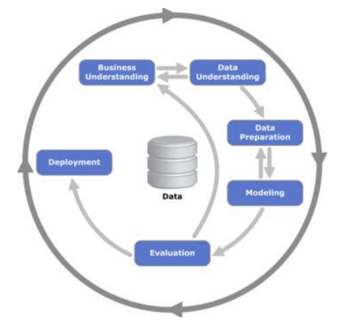
Project Methodology
CRISP-DM Framework - Cross-Industry Standard Process for Data Mining
Business Understanding : Focus on understanding the project objectives and requirements from a business perspective, then converting this knowledge into a analytics objectives and a preliminary plan to achieve the objectives.
Data Understanding : Starts with an initial data collection and proceeds with activities in order to get familiar with the data, to identify data quality problems, to discover first insights into the data or to detect interesting patterns to form hypotheses.
Data Preparation : Covers all activities to construct the final dataset from the initial raw data. Data preparation tasks are likely to be performed multiple times and not in any prescribed order. Tasks include record and variable selection as well as transformation and cleaning of data for modelling.
Modeling : Various modeling techniques are selected and applied and their parameters are set to optimal values. Some techniques have specific requirements on the form of data. Therefore, stepping back to the data preparation phase is often necessary
Evaluation : Thoroughly evaluate the model and review the steps executed to be certain it properly achieves the business objectives. At the end of this phase, a decision on the use of the analytics results should be reached
Deployment : Once the model is created and tested and evaluated on the Test and Validation data. The model the undergoes different real time evaluation and testing and after all the approval process, the code is pushed to the PROD/Live data.

Slide 7
Business Understanding
The client is a large MNC which sells software products and services in business applications and consulting.
This project aims to provide algorithmic solutions to the team in predicting the disputed invoice will get either approved or rejected based on the features like, reasons for :
Department wise rejections ?
Reasons for raising disputes ?
Which customer raises more disputes ?
Who approves / rejects the disputed invoices ?
Country wise disputes ?
Dataset
ML
Model
Prediction of Disputed Invoice
Algorithmic Solution for Disputed Invoice Prediction

Slide 8
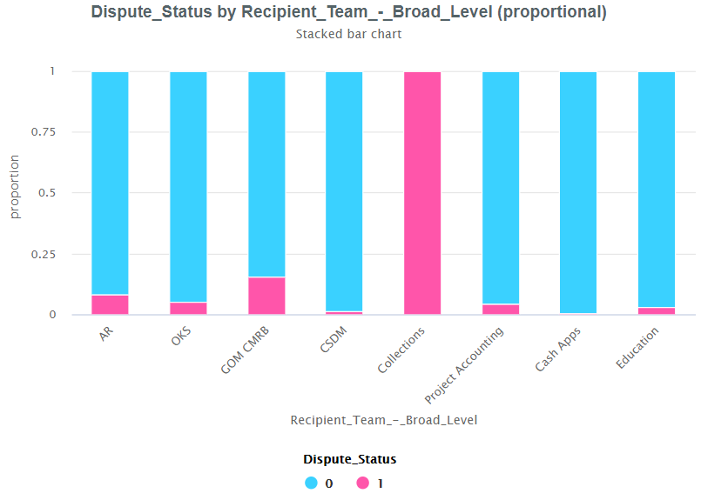
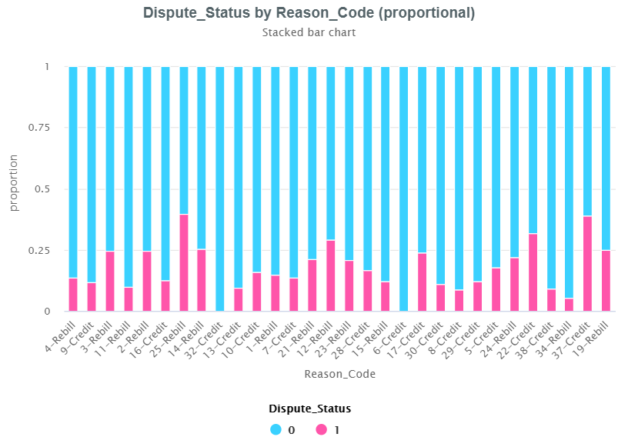
Data Understanding
Oracle Reports
ERP System
downloaded
Files in .csv
masked
Files in .csv
Collections Department has the highest level of rejection.
Cash Apps team has minimum number of rejections.
Department wise rejections
Rebill (Code-25), Credit (Code-37), Credit (Code-22), Rebill (Code-12), Rebill (Code-19) are the reasons codes with more number of rejections.
Credit (Code-32), Credit (Code-6) are with minimum number of rejections
Reasons for Disputes

Slide 9
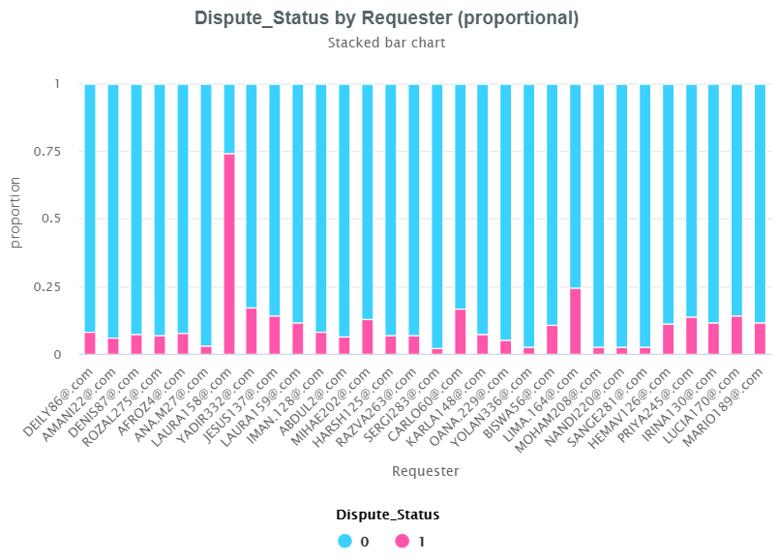
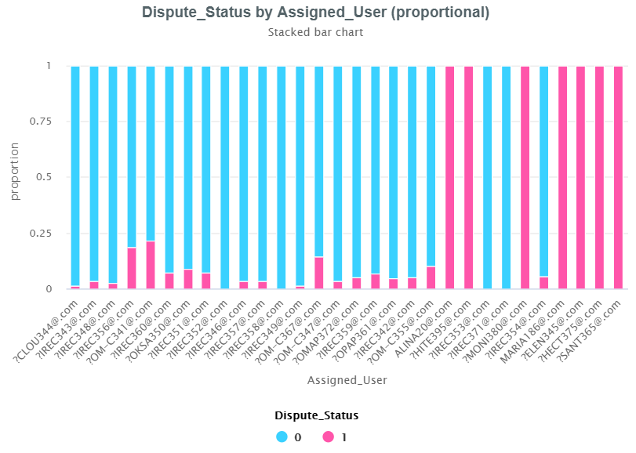
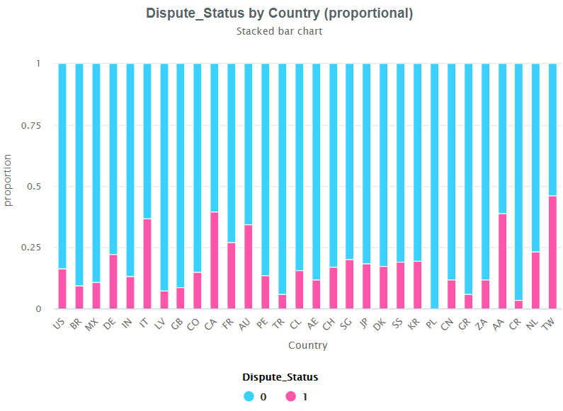
Data Understanding
ALINA20@.COM, HITE@.COM,
MONI@.COM, MARIA186@.COM, ELEN345@.COM, HECT375@.COM, SANT365@.COM are the assigned users who have rejected the maximum number of disputed invoices.
Who Raises Disputes More
Taiwan, Canada, Aruba, Italy and Australia have the highest number of disputed rejections.
Poland and Costa Rica have the minimum number of rejection of disputed invoices.
Who Rejects the Disputed Invoices
LAURA158@.COM, LIMA@.COM and YADIR@.COM are requestor who has the highest number of rejection of disputed invoices.
Country wise Disputes

Slide 10
Data Preparation
EDA Analysis using Pandas Profiling
Test Between | P-Value | Decision : Relationship Between Variables
Dispute_Status and Assigned_User | 0.0 | Yes
Dispute_Status and Trx_Type | 0.00019 | Yes
Dispute_Status and Reason_Code | 0.00000 | Yes
Dispute_Status and Requester | 0.00000 | Yes
Dispute_Status and Country | 0.00000 | Yes
Dispute_Status and RecipientTeam_BroadLevel | 0.00000 | Yes
Chi-Square Test Analysis
Features Removed or Modified for the Further Analysis
Features | Comments for dropping the features
Dispute no | Unique Numbers
Customer Number | Unique Numbers for Customers
Updated Activity Result | High correlation and Post factor feature
New Invoice Amount | Post factor feature
Activity Result | High Correlation and Post factor feature
Activity Status | High Correlation and Post factor feature
Approval Date | Post factor feature
Credit Memo Creation Date | Post factor feature
Credit Memo Amount | Post factor feature
Creation Date | Dropped and split the columns into Day, Month and Week
Days Pending | Calculated feature

Slide 11
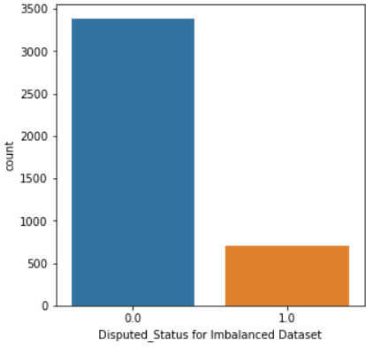
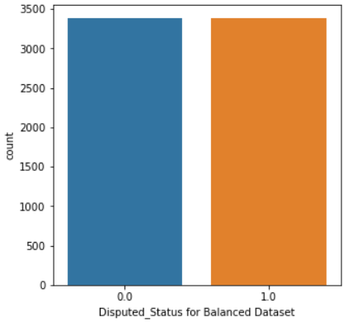
Data Preparation
Data Preparation Steps:
Disputed Status is a categorical feature with the values Complete, Cancelled, Not Approved, Pending Approval and Approved Pending Comp. Based on discussion with domain expert and on the final status of disputed invoice, disputed status is reduced to Approved, Rejected and Pending Approval.
Dataset is split into three categories training, validation and test set.
Training and Validation dataset contain disputed status either approved or rejected.
Test set is used as the deployment data for re-validation of the model.
Training dataset is imbalanced dataset; it’s balanced before building the model.
SMOTE packages was used for balancing the data.
Imbalanced Dataset:
Disputed status has the very high difference between the approved and rejected status values. Thus we say that the dataset is imbalanced.
Balanced Dataset: Disputed status have approximately or same number of approved or rejected status values. Then we say dataset is balanced.

Slide 12
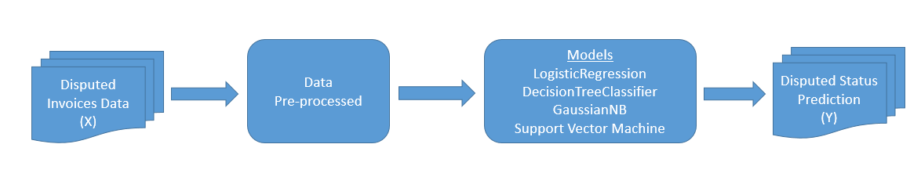
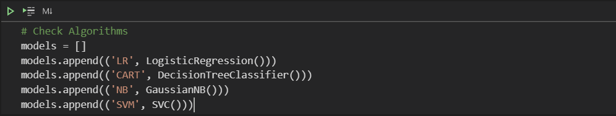
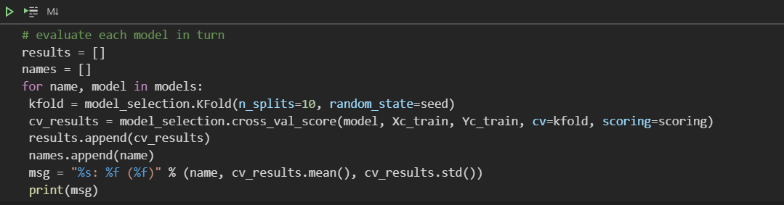
Data Modeling
Overview of the dataflow into Machine Learning Data Model
Classification Models used for Data Modeling

Slide 13
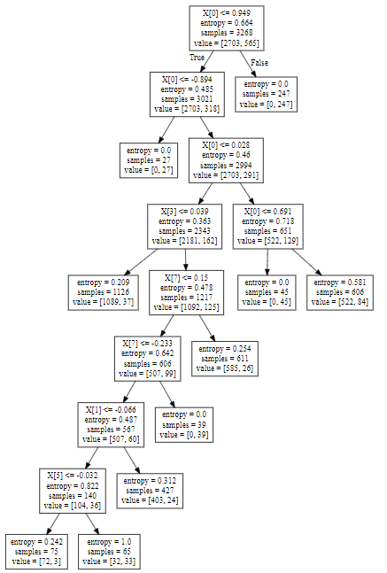
Data Evaluation
Models | Accuracy
Logistic Regression | 89.63%
Decision Tree Classifier | 93.45%
GaussianNB | 88.53%
Support Vector Machine | 90.09%
Models | Accuracy
Logistic Regression | 46.26%
Decision Tree Classifier | 96.11%
GaussianNB | 49.58%
Support Vector Machine | 49.79%
Accuracy Metrics for Imbalanced data
Accuracy Metrics for Balanced Data
Decision Tree, we see that
X [0] Assigned User an entropy of 0.664
X [3] Dispute Amount, X [7] Recipient Team – Board Team,
X [1] Invoice Amount X [5] Requestor.
Many machine learning models are designed around the assumption of balanced class distribution, and often learn simple rules (explicit or otherwise) like always predict the majority class, causing them to achieve an accuracy 99 %.
Classification accuracy fails on classification problems with a skewed class distribution because of the intuitions developed by practitioners on datasets with an equal class distribution.
Decision Tree - parameter of max_leaf_node of 10

Slide 14
Deployment
Row Labels | Count of Predicted_Dispute_status
0 | 338
1 | 577
Grand Total | 915
Out of 915 disputed invoices338 were rejected and 577 were approved.
Dispute status value will be validated against the actual status of disputed invoice number from the organizations based on which next actions will be taken for the implementation of the model.

Slide 15
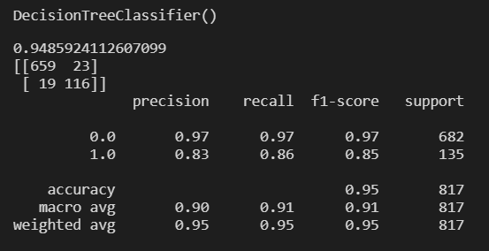
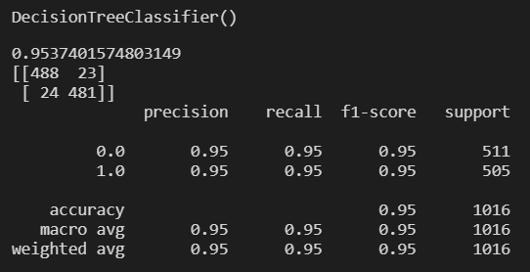
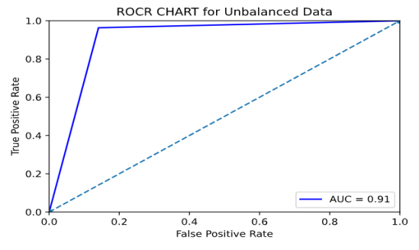
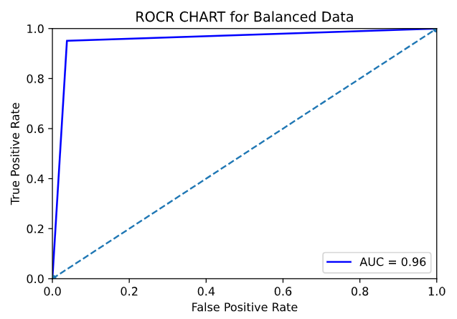
Analysis and Results
Metrics for imbalanced data
Metrics for balanced data.
Confusion Matrix: Model was able to identify 659 approved statuses correctly, with 23 approved statuses was identified wrongly. 116 rejected statuses were identified correctly with 19 rejected statuses identified wrongly from the imbalanced data.
Precision value for imbalanced and balanced is around 0.95 for predicting the approved status and 0.83 for unbalanced, 0.95 to the balanced data, i.e. the performance of the model can correctly predict the true positive values from the false positive values for the approved dispute status. Value closer to 1 is the better model.
Recall metric value for imbalanced and balanced is around 0.95 for approved status and 0.86 for unbalanced and 0.95 for balanced data, i.e. the performance of the model can predict the true positive from total positive values for the approved dispute status. Value closer to 1 is the better model.
AUC in ROC graph is closer to top left corner indicting the better performance. This metric holds good for the balanced dataset, not preferred for the imbalanced data.

Slide 16
Conclusions and Recommendations for future work
Project solely focuses on the predicting the disputed invoices will get approved or rejected based on ML model, where the model studies the historical data and reduce the number of disputed invoices rejections and make the customers pay the invoice well with in time.
Recommendations for further work: Project does not cover why these disputed invoices gets created.
At a high level the data shows the following:
Who are the customers who regularly create these disputes ?
Which countries maximum number of invoices which are disputed ?
The reasons quoted for disputes etc.

Slide 17
GitHub Link
GitHub Link Contains:
Code
HTML Files for Pandas Profiling
HTML File for Code Output
GitHub Link :
https://github.com/kyasanur/Predicting-Dispute-Status-using-Machine-Learning-Approach

Slide 18


